Slide 1
Mandli Communications, Inc.
SECTION 4
ADA Compliance

Slide 2
Accessibility Elements
Curb Ramp
Pedestrian Signals
Pedestrian Crossing
Sidewalk

Slide 3
Curb Ramp Elements
Type | Perpendicular, Parallel, Median Island, Other, Missing
Location | Corner, Midblock
Position | Latitude, Longitude, Altitude
Warning Texture Spans Ramp | Y/N
Warning Texture Contrast Color | Y/N
Path Obstruction | Y/N
Horizontal Obstruction | Y/N
Vertical Obstruction | Y/N
Temporary Obstruction | Y/N
Gutter Turn Space (within Paint >4 ft) | Y/N
Landing Turn Space Constrained | Y/N
Slope: Ramp, Landing, Gutter, Flare | Degrees or %
Cross Slope: Ramp, Landing, Gutter | Degrees or %
Width: Ramp, Landing | Inch
Depth (Turn Space): Gutter, Landing | Inch
Accessibility Condition | Good, Poor, Unknown*

Slide 4
LiDAR vs Hand Measurements
 | Gutter | Landing | Ramp | Overall
Slope | 1.46 | 0.81 | 0.84 | 1.25
Xslope | 0.87 | 0.73 | 1.62 | 1.15
Standard Error @ 2sigma
Units = degrees
95% of slope error ≤ 1.25 degrees
95% of cross slope error ≤ 1.15 degrees
Error trends negative, meaning slope is under reported
Slope accuracy (2σ + bias) 95% of slope measurement are within 2.015 degrees
Cross slope accuracy (2σ + bias) 95% of cross slope measurements are within 1.742 degrees

Slide 5
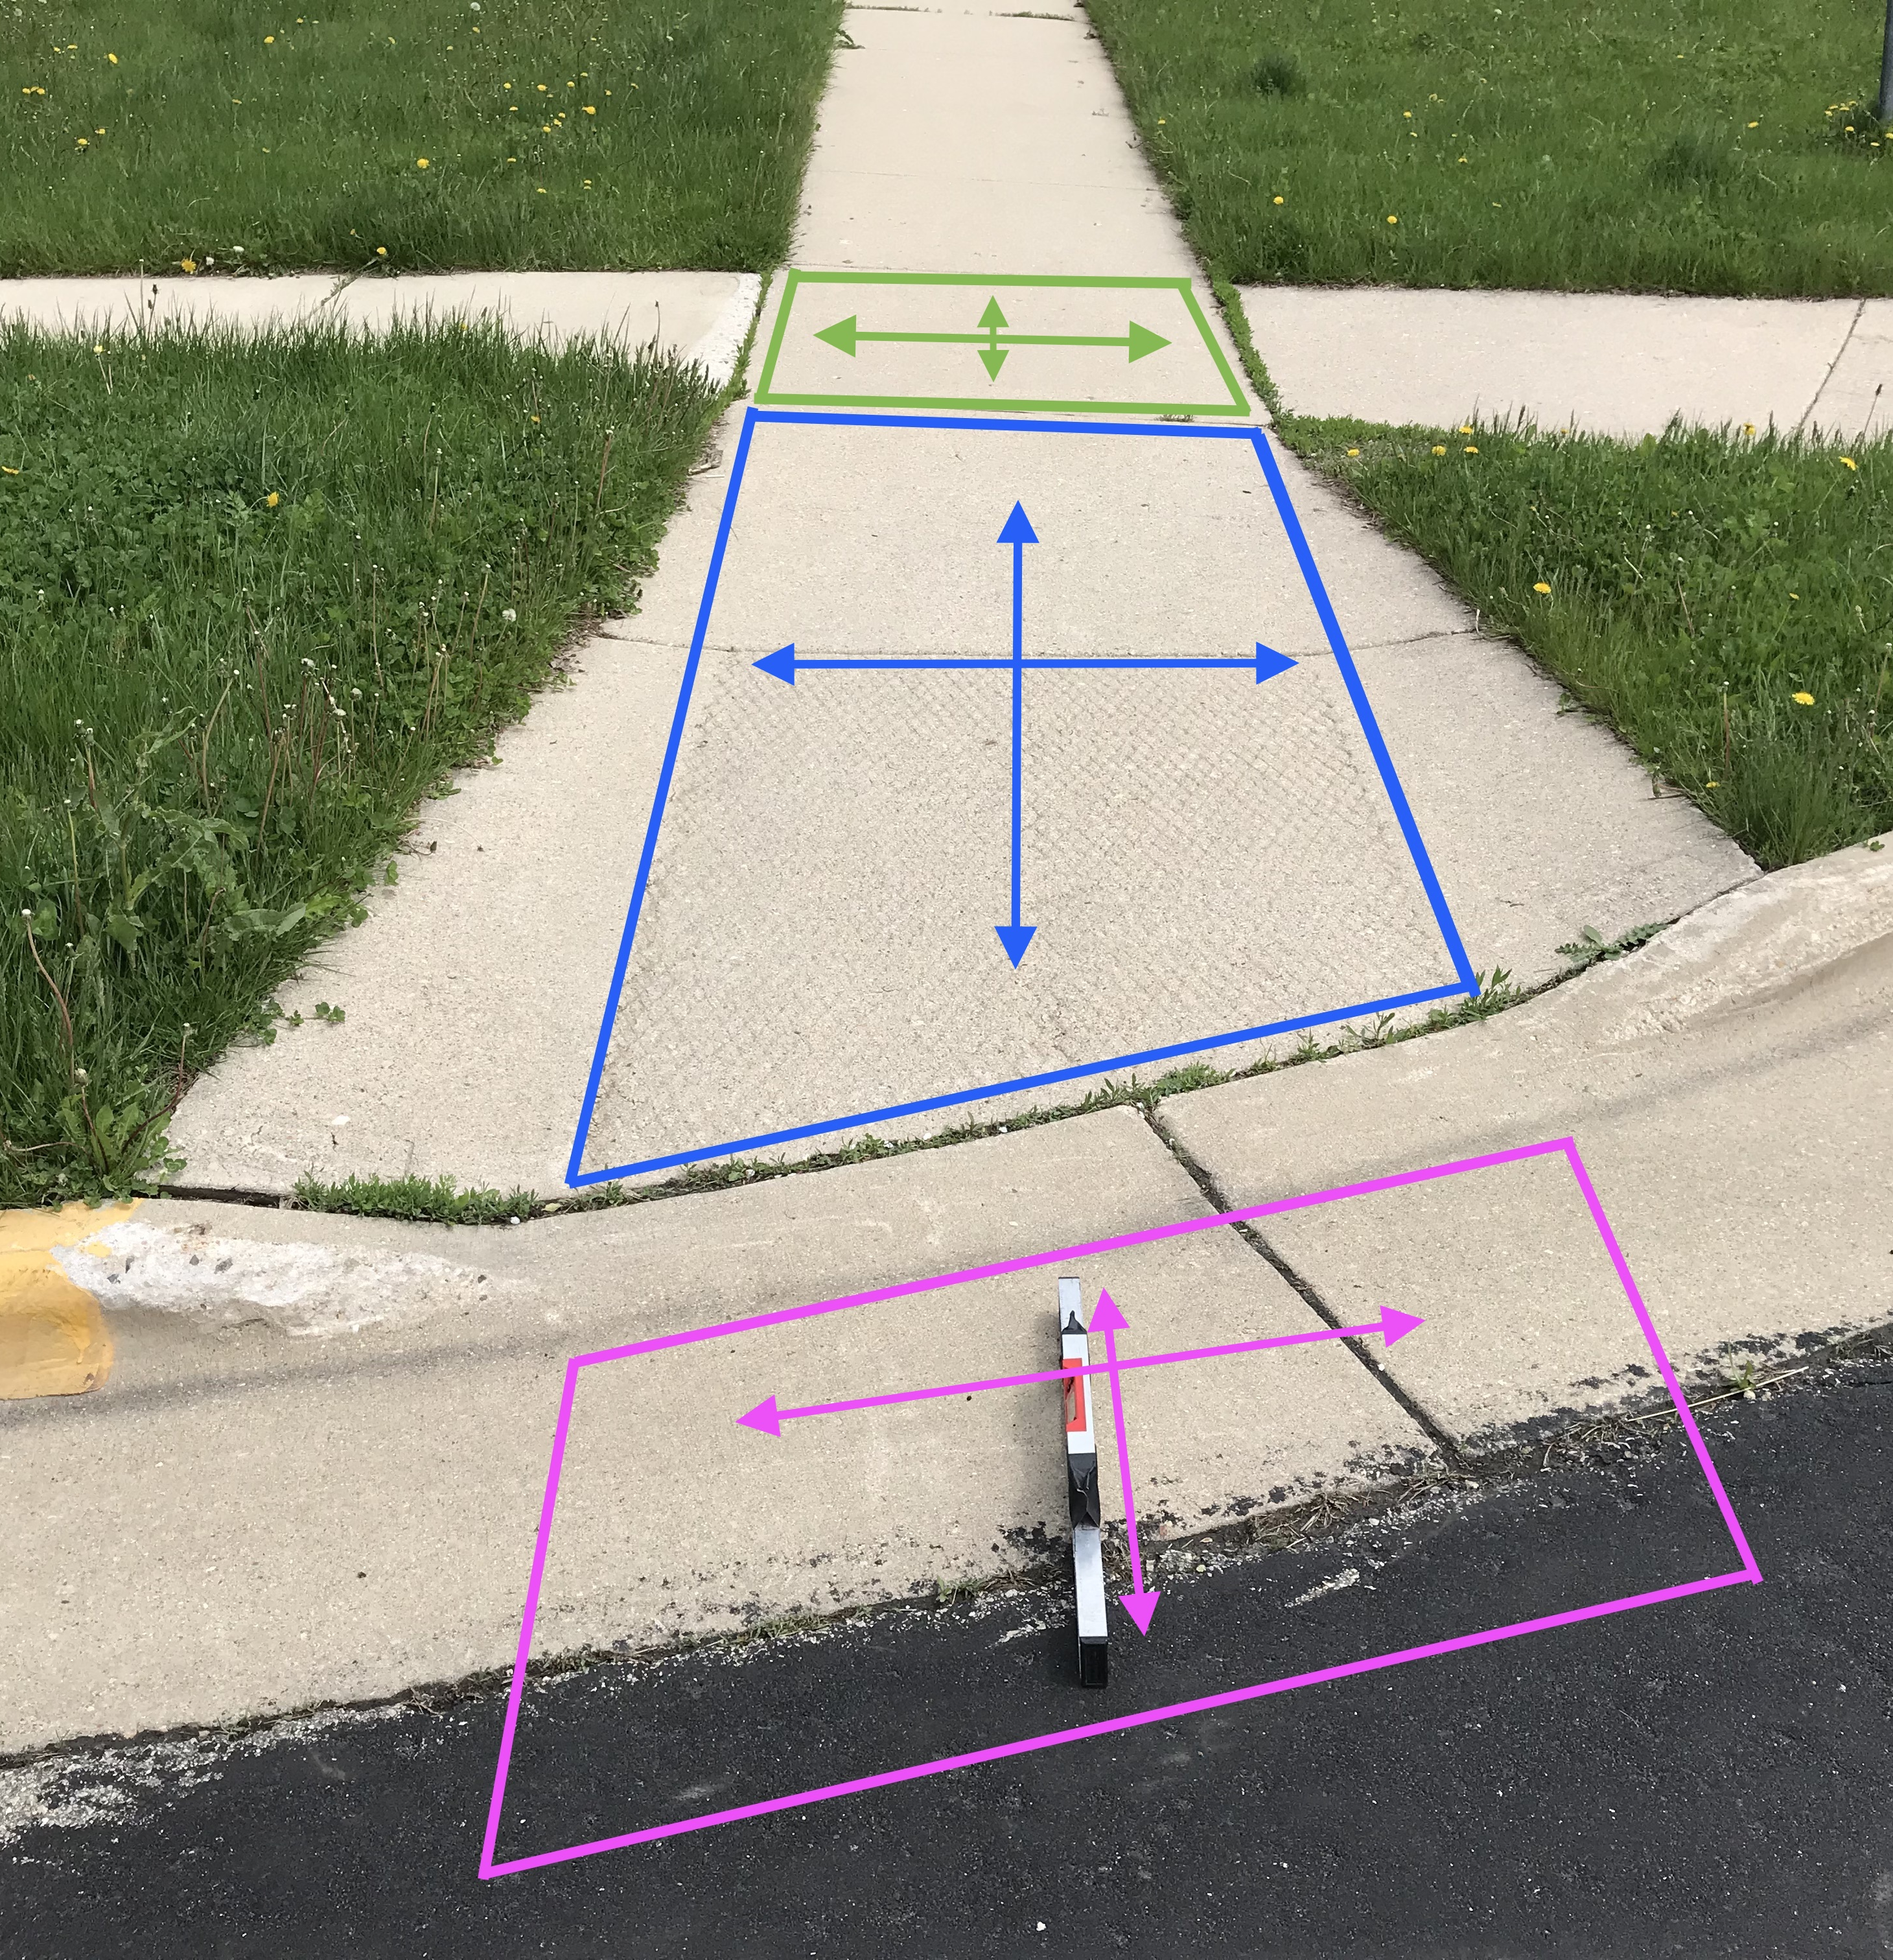
MANUAL MEASUREMENTS
2 ft digital level
25 ft steel measure tape
Survey123 mobile app
Modeled on Cambridge, MA DPW 2008 Ramp Inspection Form

Slide 6
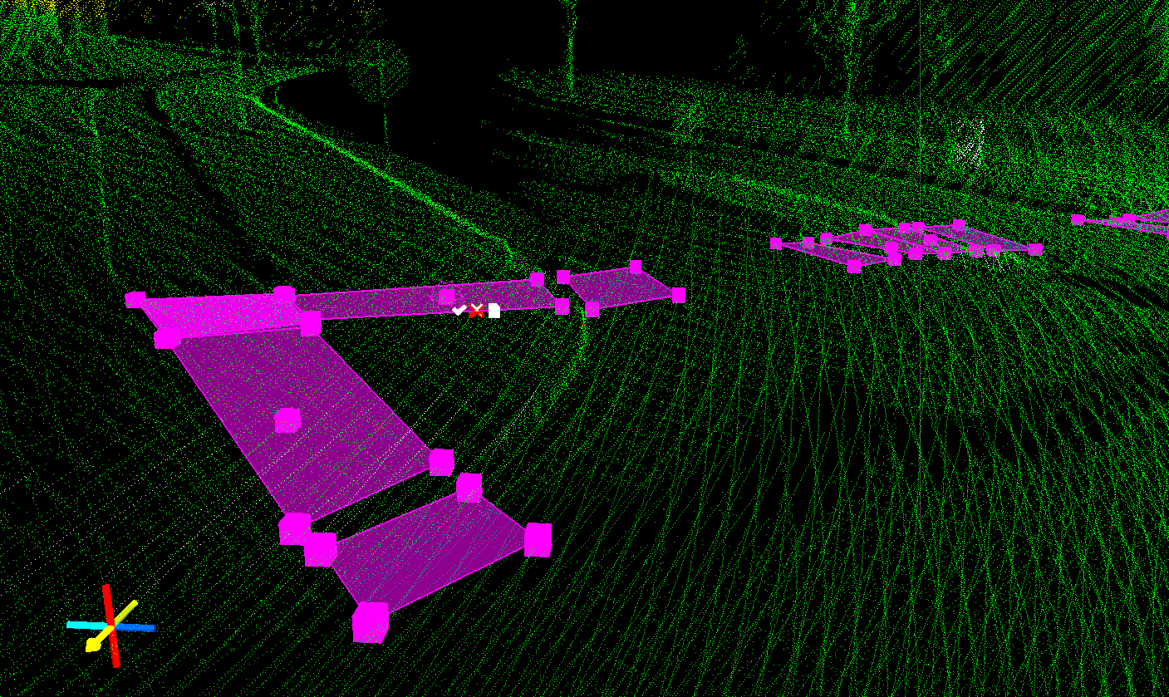
Notes:
Marketing commit to specific roadmap for aADA

